Slide 1
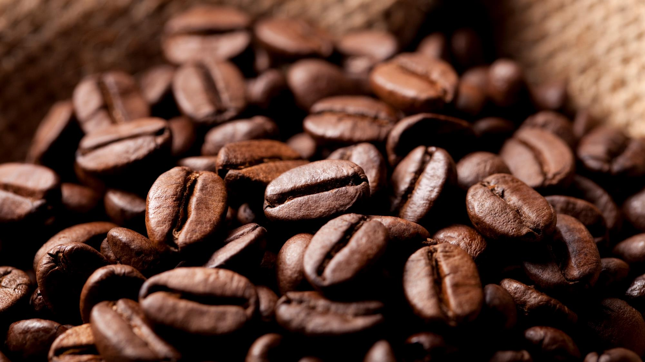
Bright coffee shop
SALES ANALYSIS BY: Gomolemo Moabalobelo

Slide 2
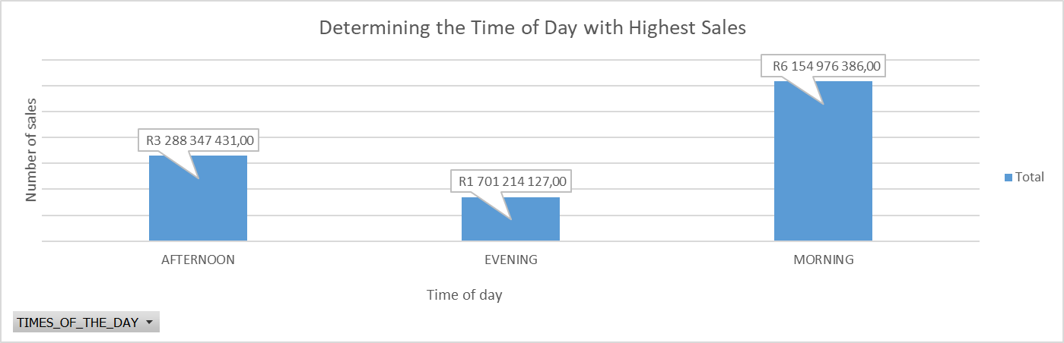
SALES PER TIME OF DAY
The was a decline in sales of approximately 46.6% from morning to afternoon, and 72.4% from morning to evening

Slide 3
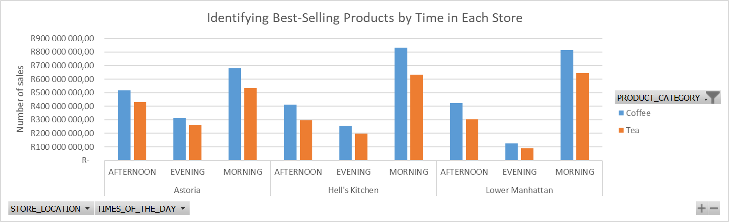
SALES PER TIME OF DAY
Coffee sells 145,734,545 more than tea in Astoria that’s 27.29% higher than tea.
Coffee sells 200,011,882 more than tea in Hell’s Kitchen that’s 31.58% higher than tea.
Coffee sells 171,986,347 more than tea in Lower Manhattan that’s 26.74% higher than tea.

Slide 4
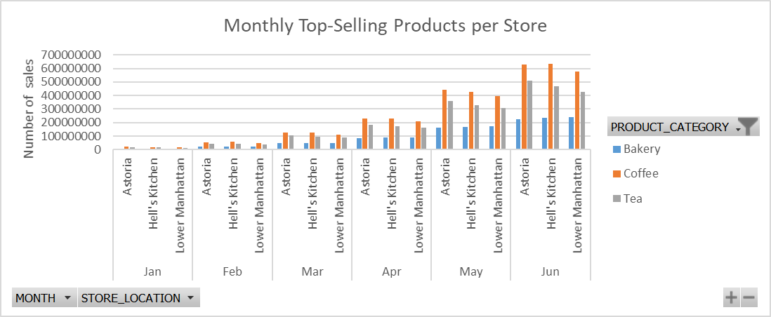
SALES PER month
We can see that coffee generates higher monthly sales compared to bakery and tea, with bakery being the lowest performer each month.

Slide 5
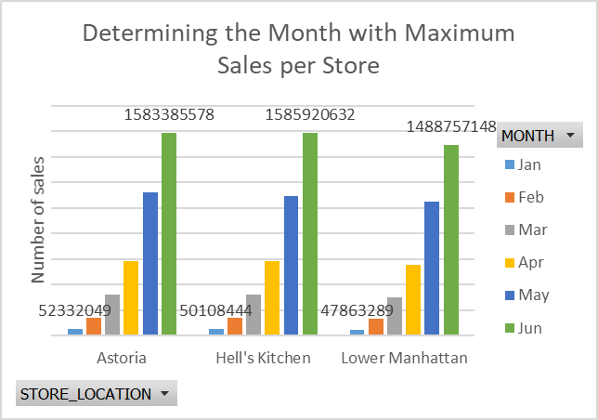
SALES PER month
At Astoria, June sales exceeded those of January by R1,531,053,529, with January sales being approximately 96.70% lower than June.
At Hell’s Kitchen, June sales surpassed January sales by R1,535,812,188, with January sales approximately 96.83% lower than June.
At Lower Manhattan, June sales were R1,440,893,859 higher than in January, with January sales approximately 96.78% lower than June

Slide 6
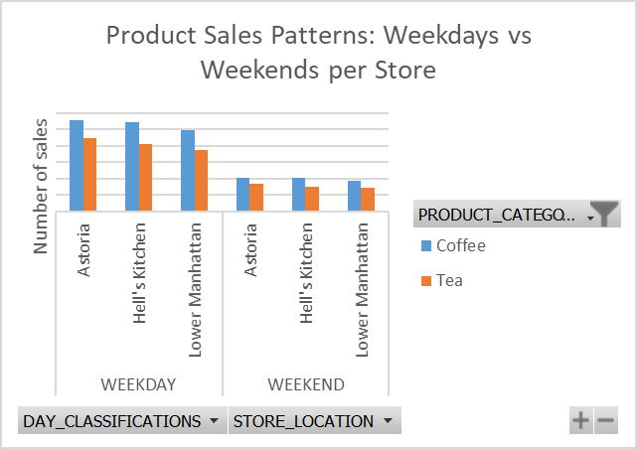
SALES: weekdays vs weekends
At Astoria during weekdays, coffee outsells tea by approximately 24.57%, while on weekends, it exceeds tea sales by about 20.59%.
At Hell’s Kitchen during weekdays, coffee outsells tea by approximately 32.59%, and this advantage increases to about 35.45% on weekends.
At Lower Manhattan during weekdays, coffee outsells tea by approximately 32.25%, while on weekends, it exceeds tea sales by about 30.72%.

Slide 7
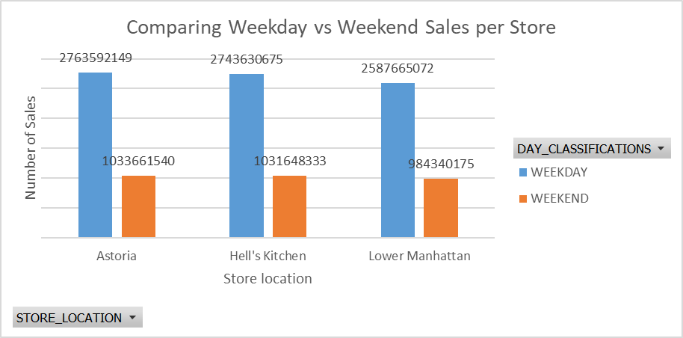
SALES: weekdays vs weekends
At Astoria, weekend sales were approximately 62.61% lower than weekday sales.
At Hell’s Kitchen, weekend sales were approximately 62.38% lower than weekday sales.
At Lower Manhattan, weekend sales were approximately 61.96% lower than weekday sales.

Slide 8
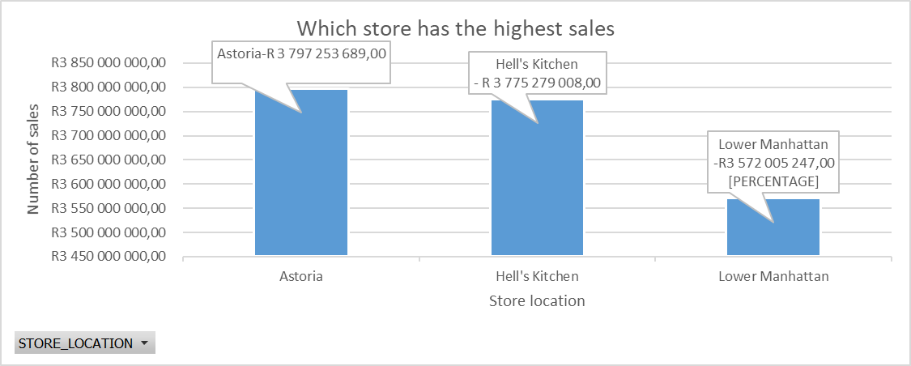
SALES per store location
Astoria’s total sales exceed Hell’s Kitchen by R71,974,681, representing a 1.93% increase. Similarly, Astoria’s sales surpass Lower Manhattan by R225,248,442, which is a 6.31% increase.

Slide 9
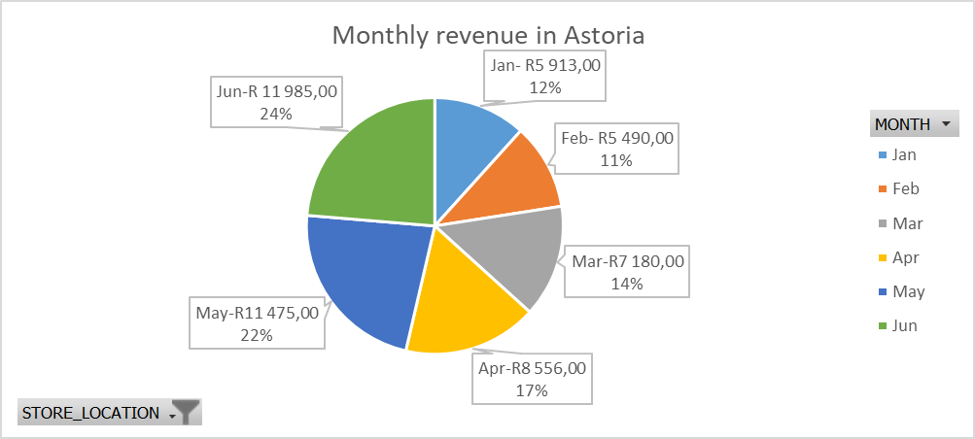
Revenue in Astoria
In Astoria, February recorded the lowest revenue of 5,490, while June recorded the highest revenue of 11,985. February’s revenue was approximately 54.6% lower than June, with June earning 6,495 more.

Slide 10

Revenue in Hell’s kITCHEN
In Hell’s Kitchen, revenue was highest in June at 12,071 and lowest in February at 5,606, with June earning R6,465 more. February’s revenue was approximately 46.41% lower than June

Slide 11
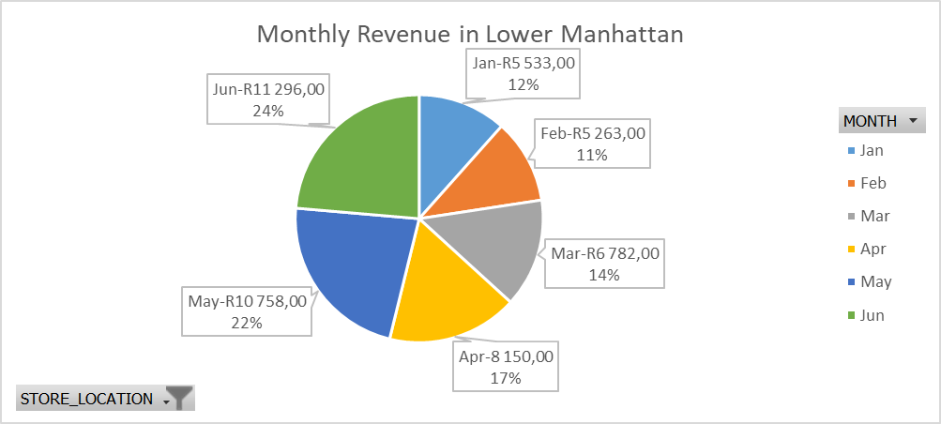
Revenue in LOWER MANHATTAN
In Lower Manhattan, revenue was highest in June at 11,296 and lowest in February at 5,263, with June earning R6,033 more. February’s revenue was approximately 46.56% lower than June

Slide 12
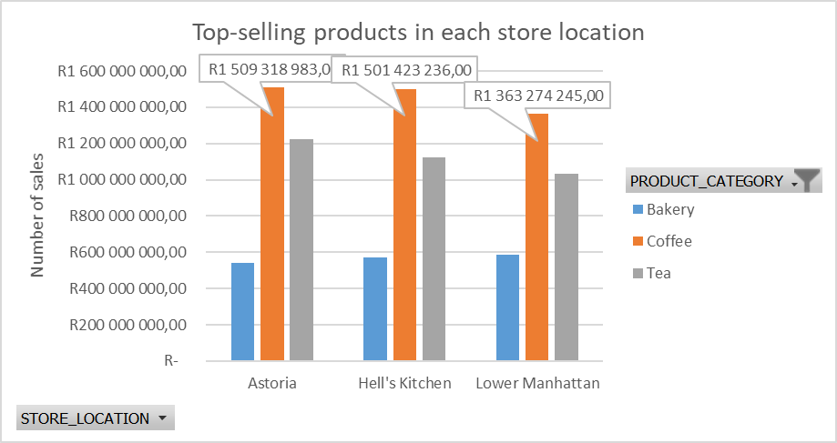
Sales per store location
At Astoria, coffee is the leading product, accounting for 46.10% of sales, surpassing both bakery and tea. At Hell’s Kitchen, coffee is the top-selling item at 46.95%, exceeding sales of bakery and tea. Similarly, at Lower Manhattan, coffee leads with 45.66% of total sales, ahead of both bakery and tea.

Slide 13
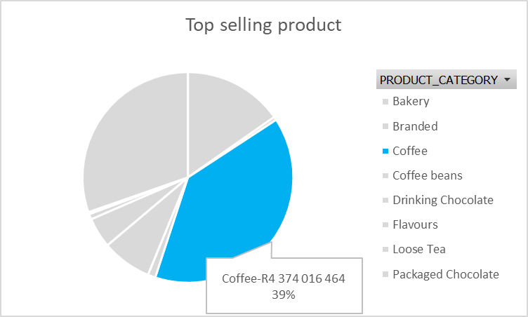
Sales per product
It is evident that coffee is the highest-selling product, representing 39% of total sales compared to other products.

Slide 14
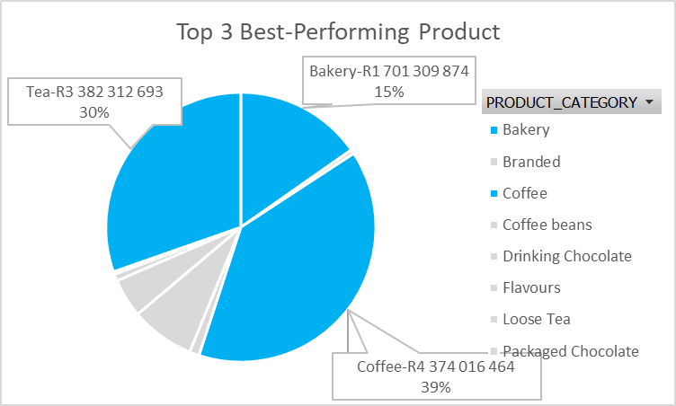
Sales per product
It is evident that coffee (39%), tea (30%), and bakery (15%) are the top-selling products.

Slide 15
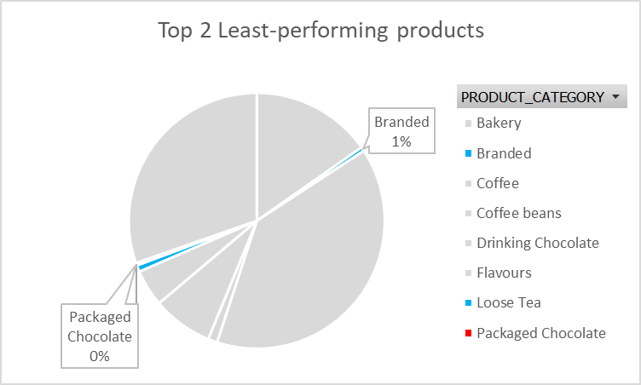
Sales per product
It is evident that branded (1%) and packaged chocolate (0%) are the lowest-selling products.

Slide 16
Conclusion
The data indicates that June is the peak revenue month across all stores, with weekdays accounting for the majority of sales. Early-year months, especially January and February, generate significantly lower revenue, revealing a clear seasonal sales pattern. Focusing on optimizing weekday performance and capitalizing on high-revenue months like June could further boost overall results, while stores such as Astoria and Hell’s Kitchen consistently outperform Lower Manhattan.

Slide 17
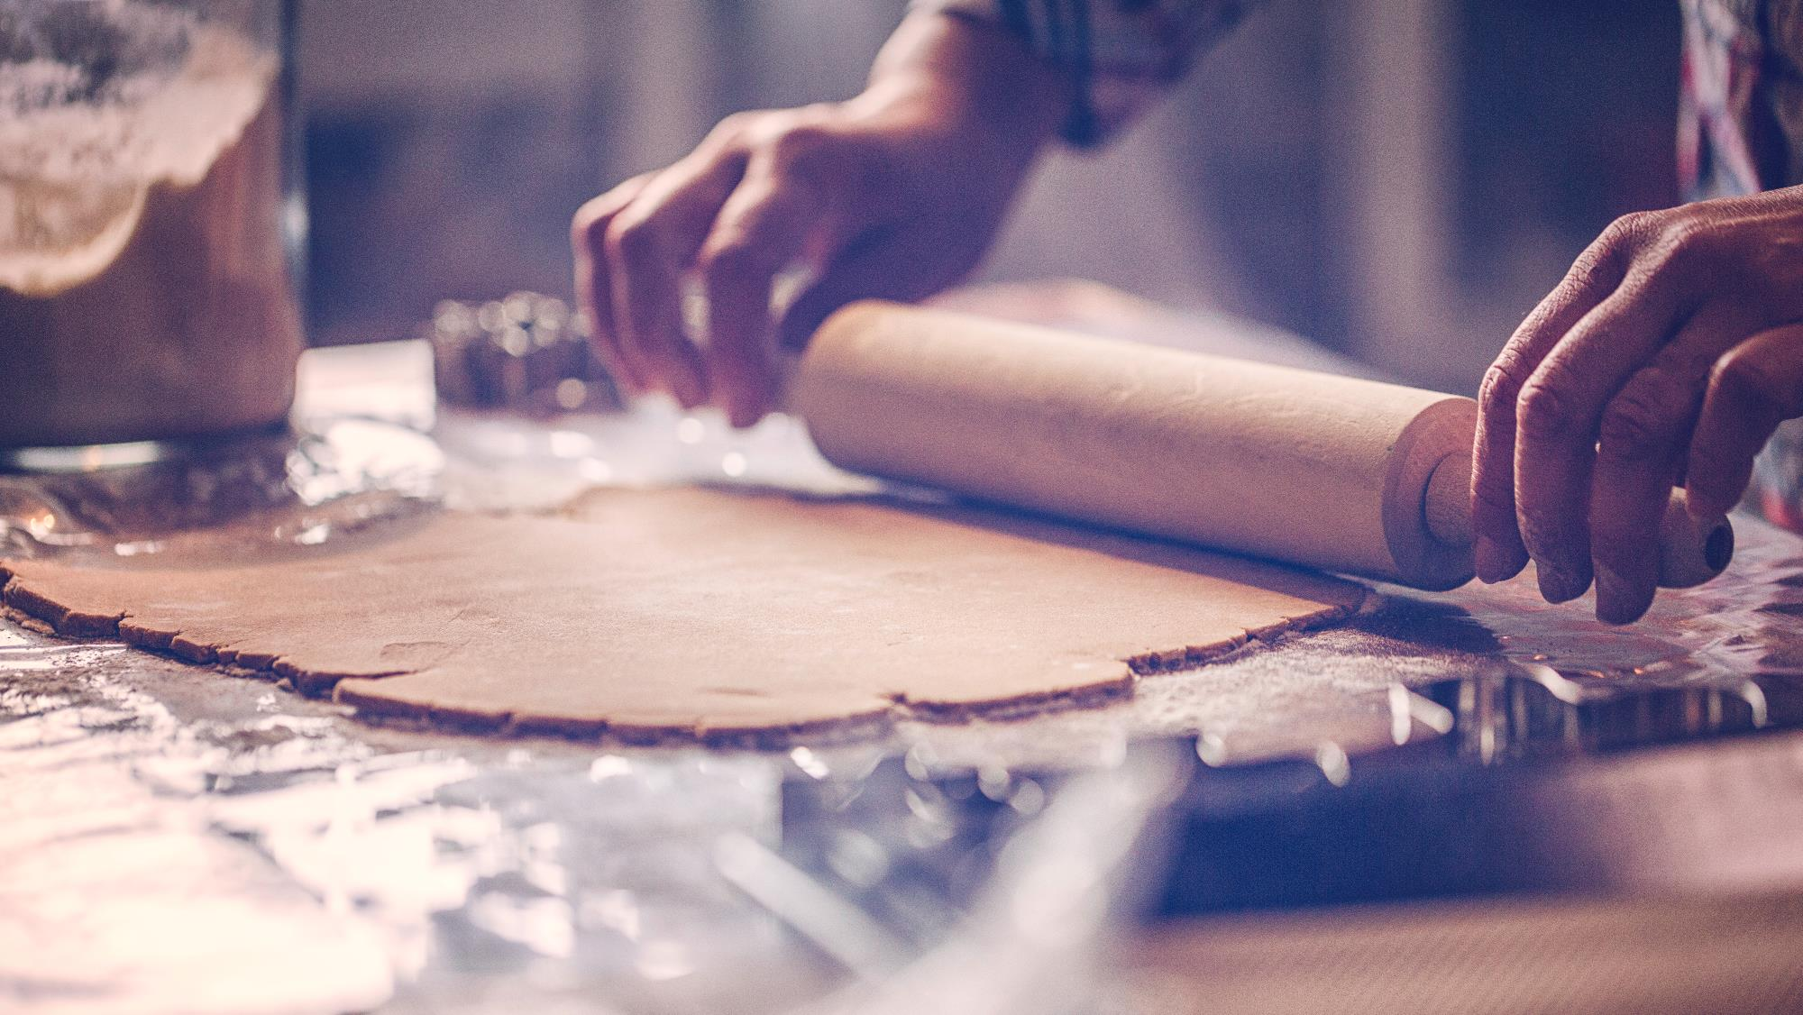

Key to Success
Maximize sales during weekdays
Leverage Peak Months
Boost Low-Performing Months
Promotions
Invest in best-sellers

Slide 18


Thank You
Email gmoabalobelo@gmail.com

